Slide 1
Capstone Project Ecommerce - Eleckart
Submitted by - Sargam Agarwal

Slide 2
Problem Statement
As a Data Scientist or an Analyst, working for ElecKart, we need to develop a market mix model based on the given information and we need to observe the actual impact of different marketing variables over the last year and recommend the optimal budget allocation for different marketing levers for the next year.

Slide 3
Objective
We are required to create market mix models for the three different product sub-categories:
camera accessory
home audio
gaming accessories
To ensure that the budget is used effectively, we must monitor the actual effects of various marketing variables for the year (2015–2016) and make recommendations for the best budget allocation for the various marketing levers for the next year.

Slide 4
Business Objective
Business Understanding and Data Cleaning
Exploratory Data Analysis
Feature Engineering
Model Building
Deriving insights based on the results
Recommendations to the business

Slide 5
Summary of Business Understanding
We have consumer data that includes details of each purchase, user zip code, and order ID.
Media investment data provides information on spending across various channels such as TV and radio.
Climate data for the Ontario region is available for the years 2015 and 2016.
NPS score data offers insights into customer satisfaction, which can impact stock market prices.
A list of local holidays is provided, with the first and fifteenth of each month designated as pay dates.

Slide 6
Data Cleaning Steps
The sole purpose of data understanding and data cleaning is to deal with inconsistencies in the dataset such as missing values, exponential values present in certain fields etc. We also convert the various datatypes to a common datatype which will help us in analysis.
Converted relevant fields to datetime datatype
Dataframes with negative values for columns like deliverybdays, deliverycdays and product procurement sla are removed/dropped
Treated GMV values w.r.t mrp units
Eliminating duplicate Dataframes and columns
Filtered the data with 3 categories: Gaming Accessories, Camera Accessories, Home Audio Accessories
Removed few columns which does not add any value to the analysis

Slide 7
KPIs and Expected Results
Gross Merchandise Value (GMV), also known as revenue, is our target variable (independent variable).
We need to identify characteristics that lead to an increase in GMV.
Dependent variables directly affecting GMV include the amount and percentage of discounts offered on products, NPS rating, etc.
Our codes indicate that NPS score, holidays, and paydates (first and fifteenth of each month) have a positive impact on sales.
We need to determine which of the three subcategories—gaming, audio, and camera—the company should invest in to boost revenue in the next financial year.

Slide 8
Steps of Feature Engineering
Create a Week column.
Update year for week 53 to 2015, despite it being 2016 in other datasets.
Drop columns with single value or all different values.
Create a feature: GMV divided by units to get the list price.
Create Payday column: flag as 1 if near salary day (1st and 15th), else 0.
Create holiday_flag: flag as 1 if holiday or occasion in Ontario, else 0.
Create Product Type column: flag as Premium_product if GMV > 80%, else mass_market.
Create dummy variables for order_payment_type.

Slide 9

Feature Engineering
Filter data from July 2015 to June 2016.
Calculate marketing spend by GMV%.
Read product list from “Media data and other information” file.
Create special sales: 0 for Nulls, 1 for event dates.
Map months to number of weeks, count 52 weeks.
Calculate 8-weeks Exponential Moving Average for all advertising media channels.
Calculate 5-weeks and 3-weeks Simple Moving Average for advertising media channels, NPS, and Stock_Index.
Create NPS (Net Promoter Score) and Stock Index as proxies for ‘voice of the customer’.

Slide 10

Steps and Visualization

Slide 11
Data Understanding
Description
FSN ID | The unique identification of each SKU
Order Date | Date on which the order was placed
Order ID | The unique identification number of each order
Order item ID | Different products under the same order generates different order Item IDs
GMV | Gross Merchandise Value or Revenue
Units | Number of units of the specific product sold
Order payment type | How the order was paid
SLA | Number of days it typically takes to deliver the product
Cust id | Unique identification of a customer
Product MRP | Maximum retail price of the product
Product procurement SLA | Time typically taken to procure the product
Additional Information
Monthly spend on various advertising channels
Days when there was any special sale on products
Monthly NPS score (this may work as a proxy to the ‘voice of the customer’)
Stock index of the company on a monthly basis
Climatic information of Ontario during 2015 and 2016

Slide 12
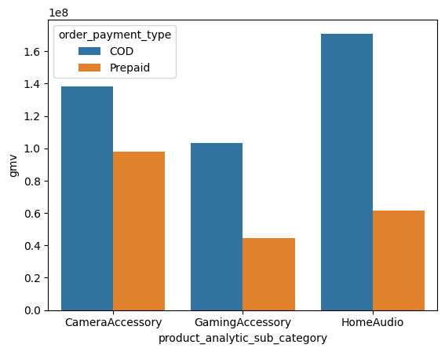
Exploratory Data Analysis
Analysis of total GMV with subcategory
Max revenue for COD order is from the class Home Audio followed by Camera
For prepaid orders, the maximum revenue is from Camera Accessory, followed by Home Audio and a slight
decrease in the category of Gaming Accessories

Slide 13
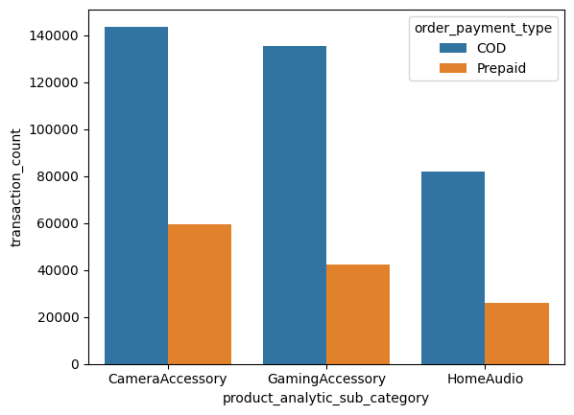
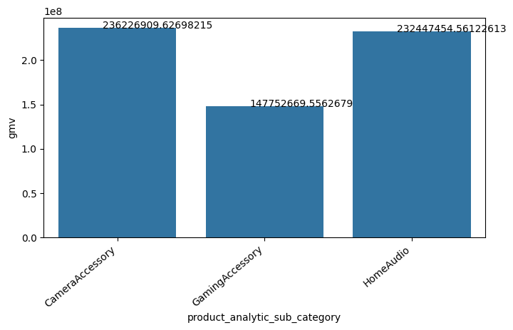
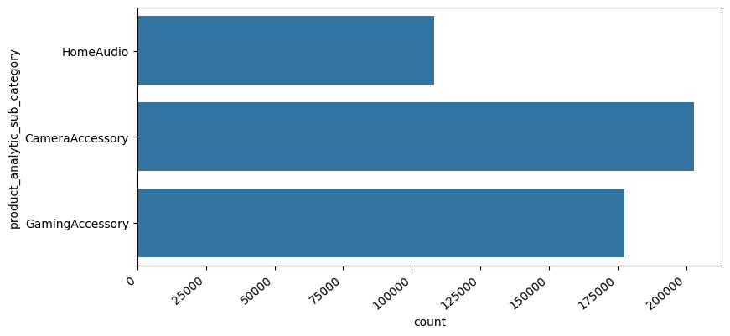
Exploratory Data Analysis
According to analysis, maximum number of transactions were from Camera Accessory category followed by Gaming Accessory category and Home Audio category
Analysis of no. of transactions based on subcategory

Slide 14
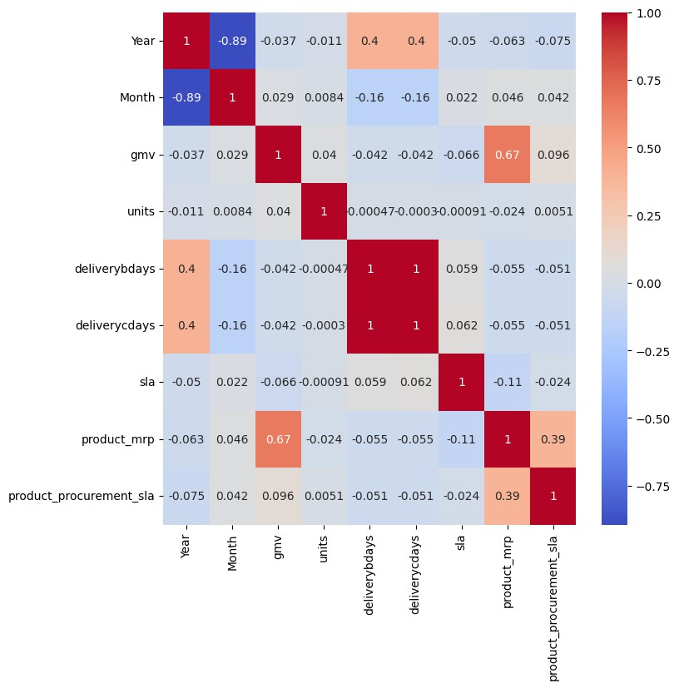
Exploratory Data Analysis
Checking Correlations
CORRELATION MATRIX : Checking the correlation Between the variables in the data set
Here we can observe that Month & Year are highly correlated.

Slide 15
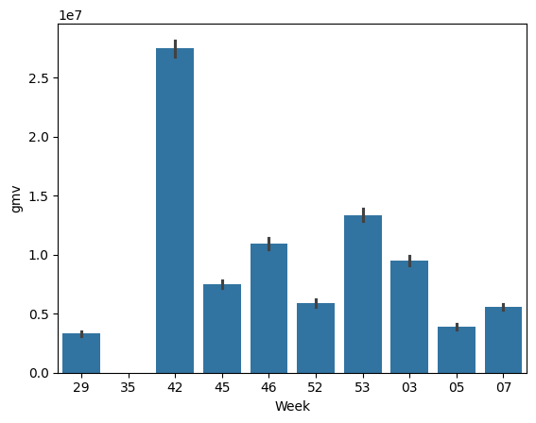
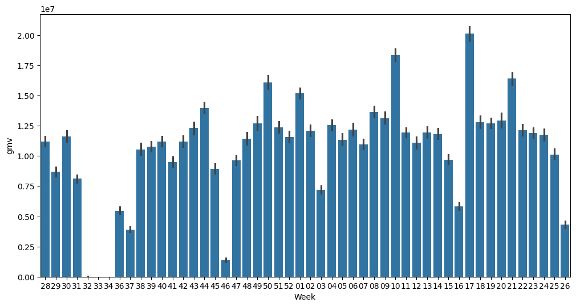
Exploratory Data Analysis
Analysis of Sales on Special Day
Plot for special sales flag = 1 (Special Sale)
Insights: The special sale day's week 42 biggest sales were noted.
Plot for special sales flag = 0 (No Special Sale)
Insights: The special sale day's week 17 has the highest observed sales of 0

Slide 16
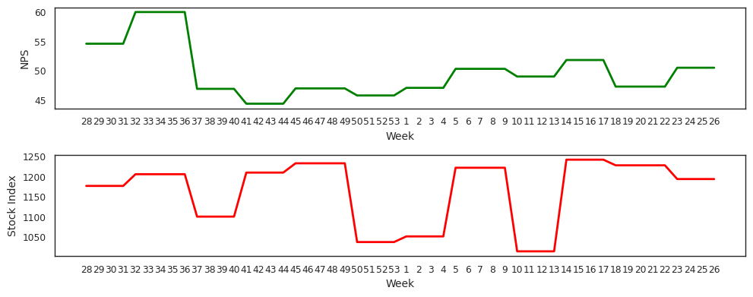
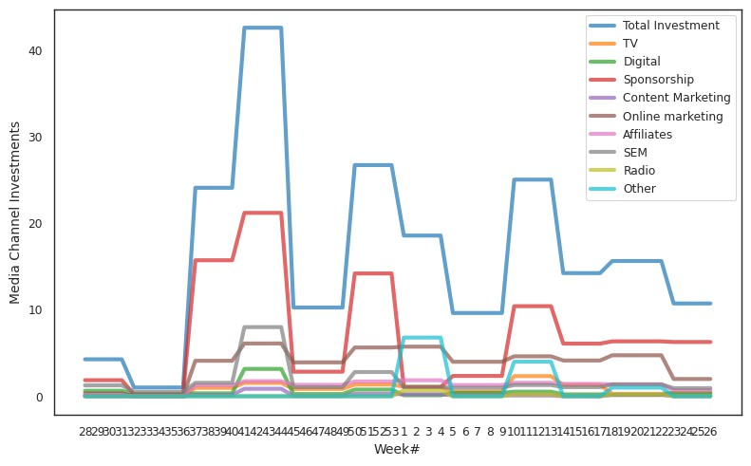
Exploratory Data Analysis
Displaying Trends
NPS and Stock Index by Week
Consumer NPS Score is highest in weeks 32 – 35, which coincides with the time when maximum discounts were being offered
Over the past year, most Ad Investments have gone to sponsorships, followed by Online and Search Engine Marketing, especially during Thanksgiving
Various Media Channel Investments by Week

Slide 17
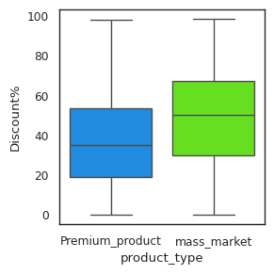
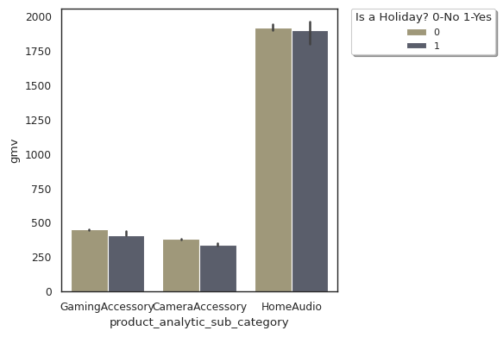
Exploratory Data Analysis
Comparing Distribution of Discount% for Product Types – Premium Products and Mass Market
Average Revenue from Holiday/Non-holiday days for the 3 product subcategories
Median Discount% offered
Luxury Items < Mass Market Products
*This is a known trend among luxury products or luxury brands to offer
limited or no discounts to retain the exclusivity of their products.
Average(Median) Revenue for 3 product subcategories from holiday and non-holiday days are more or less comparable

Slide 18
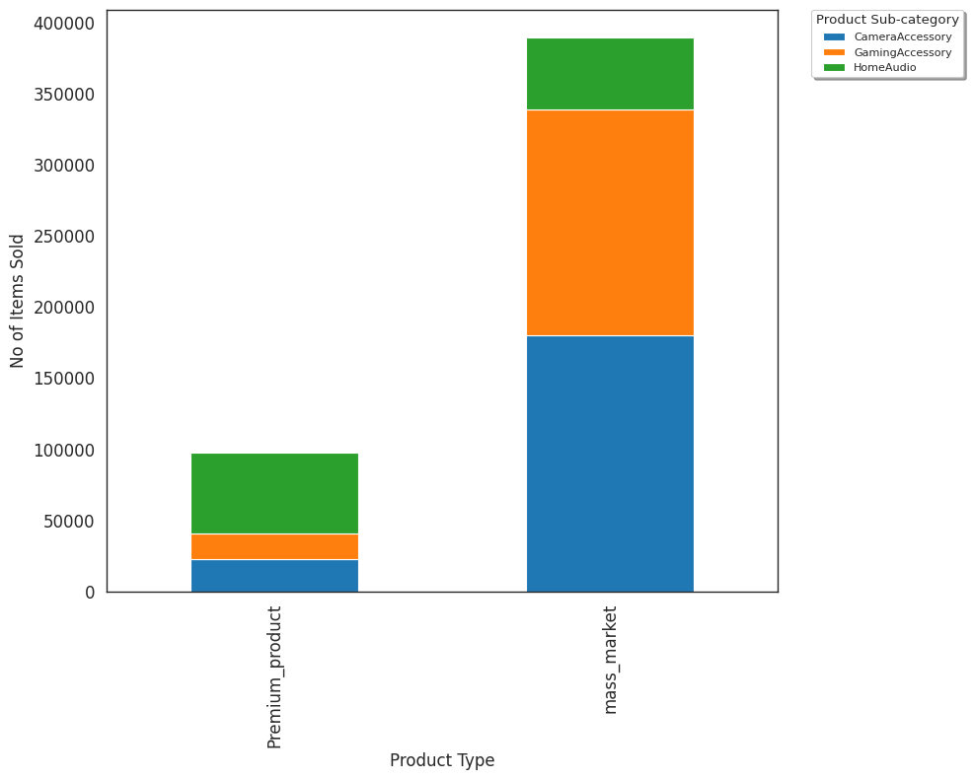
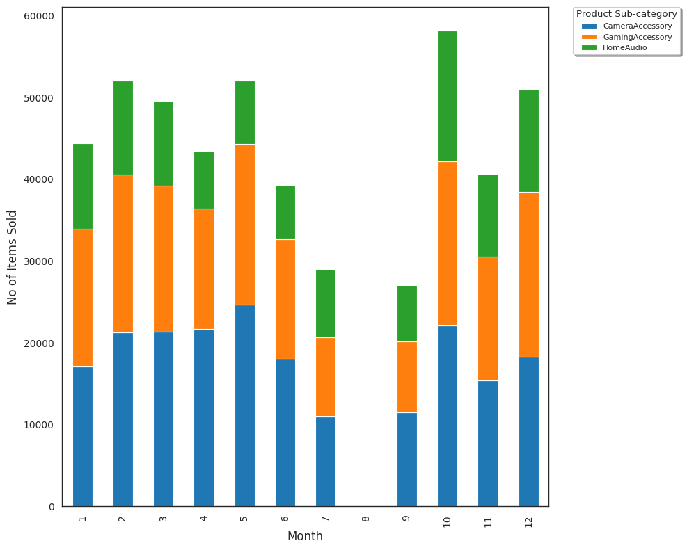
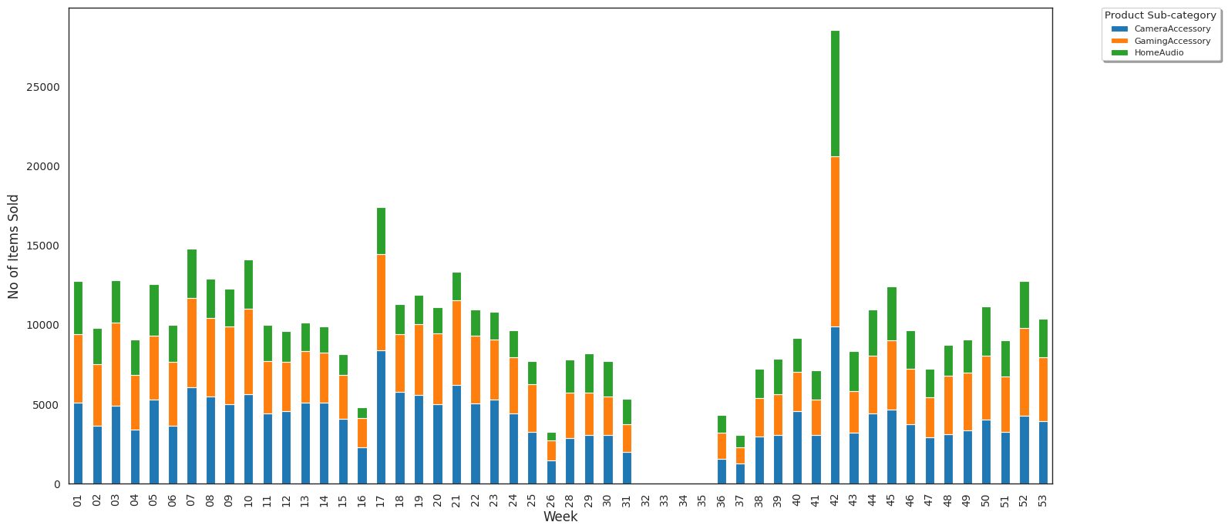
Exploratory Data Analysis
Total items sold per 3 product subcategories per month
No. of items(Premium Product/Mass Market) sold per 3 product subcategories
Total items sold per 3 product subcategories per week
Sale on 42nd week is maximum. Overall, October has seen most no. of items being sold.

Slide 19
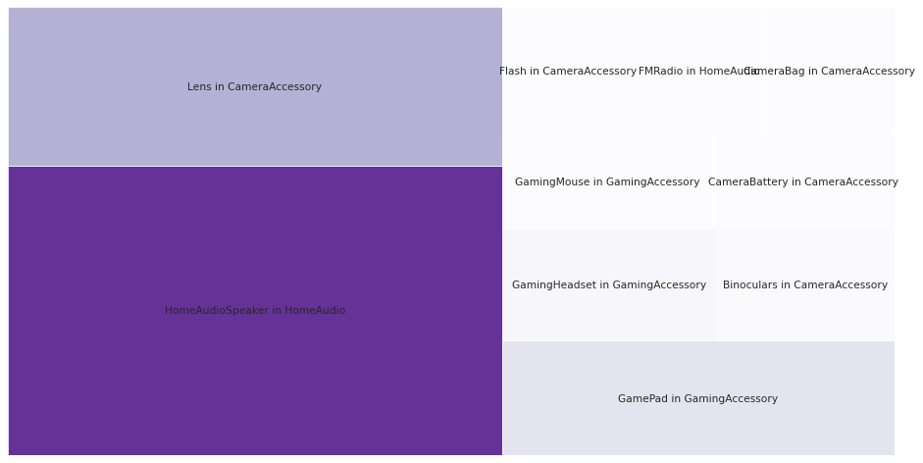
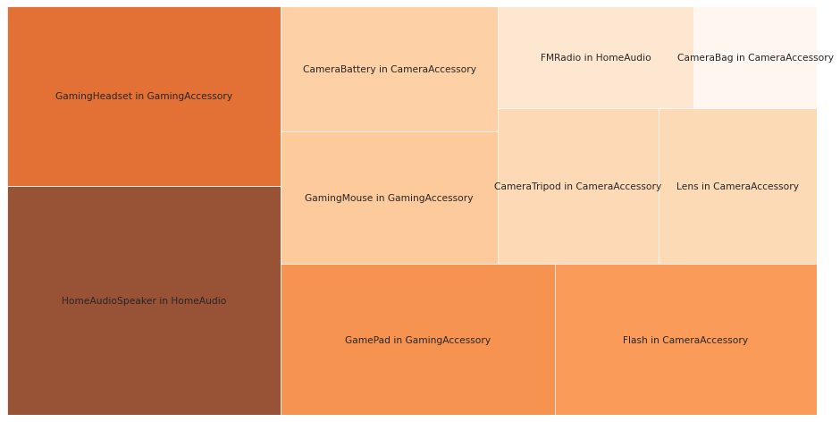
Exploratory Data Analysis
Top 10 Product Verticals which brought the Maximum Revenue for 3 Product subcategories
Top 10 Product Verticals with most no. of sales for
3 Product subcategories
Home audio speaker in home audio brought the largest revenue followed by lens in camera accessory & gamepad in gaming accessory
Home audio speaker in home audio had the most no. of sales followed by gaming headset & gamepad in gaming accessory

Slide 20
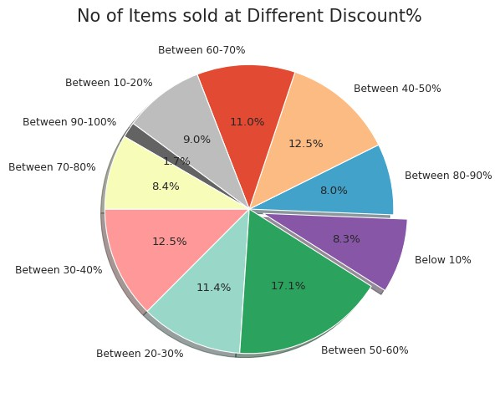
Exploratory Data Analysis
Percentage of items sold at different Discount% segments
Most Sales takes place when Discount% is between 50 – 60%

Slide 21
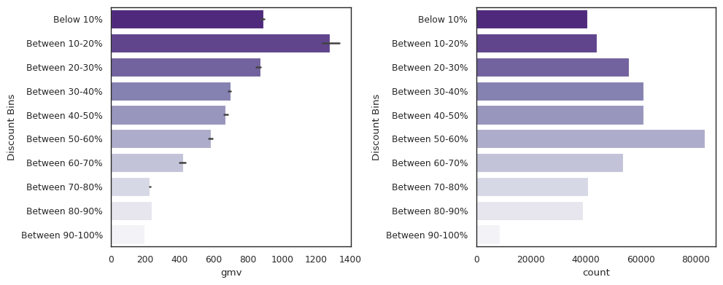
Exploratory Data Analysis
Comparison of Trends of Revenue Discount% & Total Media Investment over the weeks
Median Revenue is maximum when Average discount% is between 10-20%. But beyond that, average revenue slowly starts to decline.
The sales on the other hand shows a steady increase with increase in Discount percentage till it peaks at 50 -60% after which it starts to fall again.
This shows that at higher discount, although the sales are good, the revenue collapses signifying a loss for the company. An average discount of 10-20% is the most profitable for the company.

Slide 22
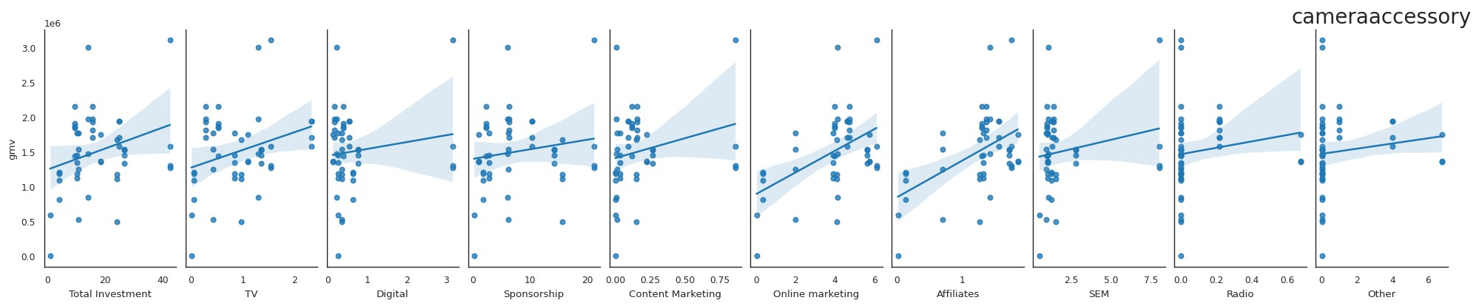
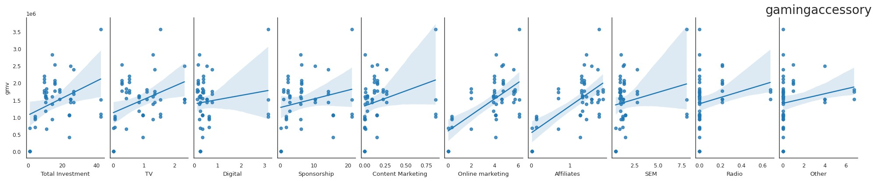
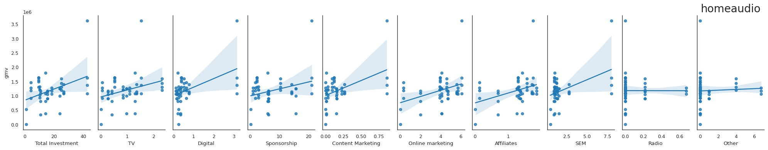
Exploratory Data Analysis
Relationship between Revenue and Advertisement spends

Slide 23
Model Evaluation – Camera Accessories
Model | Top KPI | R- Square | Adj R- Square | MSE
Simple Linear Regression | sla, is_mass_market, special_sales, product_vertical_CameraBatteryCharger, product_vertical_FlashShoeAdapter, Sponsorship, Affiliates,Radio_SMA_3 | 0.962 | 0.949 | 0.00277
Multiplicative Model | Discount%, product_vertical_Filter, Affiliates_SMA_5 | 0.987 | 0.985 | 0.00336
Koyck Model | product_vertical_CameraBattery,product_vertical_CameraMicrophone, product_vertical_CameraTripod,product_vertical_Softbox, product_vertical_Telescope,Online marketing | 0.859 | 0.827 | 0.010
Distributed Lag Additive | order_payment_type_Prepaid,product_vertical_CameraAccessory,product_vert ical_CameraBatteryGrip,product_vertical_CameraTripod,product_vertical_Flas h,product_vertical_Lens,Sponsorship_lag1,Cool Deg Days_lag1 | 0.958 | 0.944 | 0.00379
Distributed Lag Multiplicative | Discount%,product_vertical_CameraRemoteControl,Online marketing | 0.964 | 0.960 | 0.00961

Slide 24
Model Evaluation – Gaming Accessories
Model | Top KPI | R- Square | Adj R- Square | MSE
Simple Linear Regression | product_vertical_GameControlMount, special_sales, product_vertical_GamingKeyboard,Content Marketing_SMA_5, Affiliates_SMA_5 | 0.773 | 0.734 | 0.0167
Multiplicative Model | sla, product_mrp, product_vertical_GamingAccessoryKit | 0.971 | 0.968 | 0.00166
Koyck Model | product_vertical_GameControlMount,product_mrp,special_sales,TV_S MA_5, Content Marketing_SMA_5,Other_SMA_3,Total Snow (cm) | 0.706 | 0.630 | 0.0225
Distributed Lag Additive | order_payment_type_Prepaid,product_mrp,special_sales,product_vertica l_GamingAccessoryKit | 0.884 | 0.865 | 0.0075
Distributed Lag Multiplicative | product_mrp,product_vertical_GamingKeyboard,Affiliates | 0.901 | 0.892 | 0.0078

Slide 25
Model Evaluation – Home Audio
Model | Top KPI | R- Square | Adj R- Square | MSE
Simple Linear Regression | sla, product_vertical_HomeAudioSpeake, product_vertical_VoiceRecorder, Digital, Sponsorship, Sponsorship_SMA_5, Radio_EMA_8 | 0.948 | 0.933 | 0.00535
Multiplicative Model | product_vertical_FMRadio,product_vertical_HomeAudioSpeake r,Radio_Ad_Stock | 0.999 | 0.998 | 0.00035
Koyck Model | product_vertical_FMRadio,product_vertical_HomeAudioSpeake r,product_vertical_VoiceRecorder,Online marketing | 0.988 | 0.987 | 0.00060
Distributed Lag Additive | sla_lag3,product_procurement_sla_lag1,product_vertical_FMRadio,product_vertica l_HiFiSystem_lag1,product_vertical_HomeAudioSpeaker,product_vertical_VoiceR ecorder,NPS_SMA_5 | 0.990 | 0.987 | 0.00069
Distributed Lag Multiplicative | order_payment_type_Prepaid,product_mrp,Radio_lag3 | 0.899 | 0.888 | 0.2364

Slide 26
Recommendations & Results
Camera Accessory
Results: Multiplicative Model leads with Adjusted R-square of 0.985 and MSE of 0.00336.
Recommendations: Focus on Camera Filters, Accessories, and Flash via Affiliate marketing to boost visibility and sales.
Gaming Accessory
Results: Multiplicative Model scores an R-square of 0.968 and MSE of 0.00166.
Recommendations: Promote Gaming Accessory Kits with Prepaid orders and ensure SLA adherence for sustained growth.
Home Audio
Results: Multiplicative Model dominates with R-square of 0.999 and MSE of 0.00035.
Recommendations: Promote Home Audio Speakers & FM Radios to maximize revenue. Expanding the product lineup could further boost GMV.

Slide 27
Thank you

